Slide 1

Computational Methods in
Power System Analysis
Lecture-10 Solution of Simultaneous Algebraic Equations And Load Flow Studies
By
Dr. Wazir Muhammad Laghari
Electrical Engineering Department
BUET, Khuzdar

Slide 2
Methods to Solve Solution of Simultaneous Algebraic Equations
Direct Method Iterative Method
Elimination Decomposition
Jacobi’s
Method
Gauss-Seidel
Method
Relaxation
Method
Gaussian Elimination Method
Gauss-Jordan Method
Crout’s Reduction Method
Cholesky’s Reduction Method

Slide 3
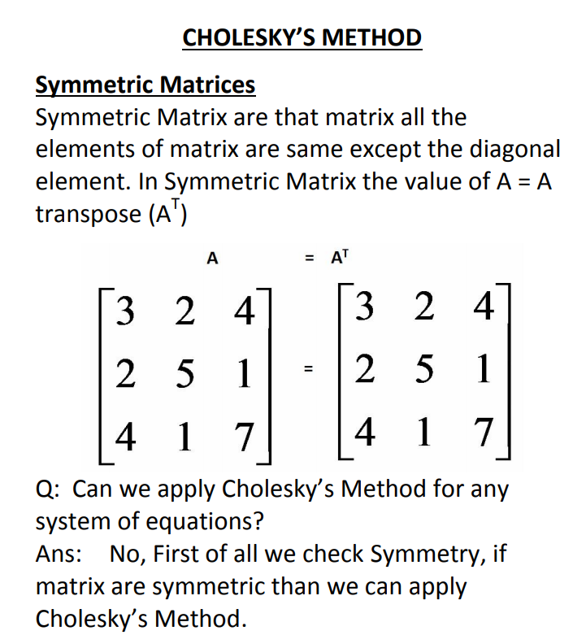
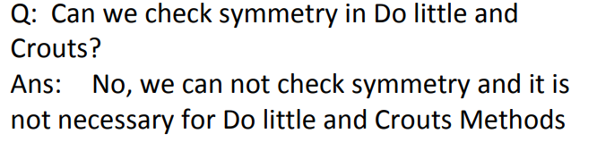

Slide 4
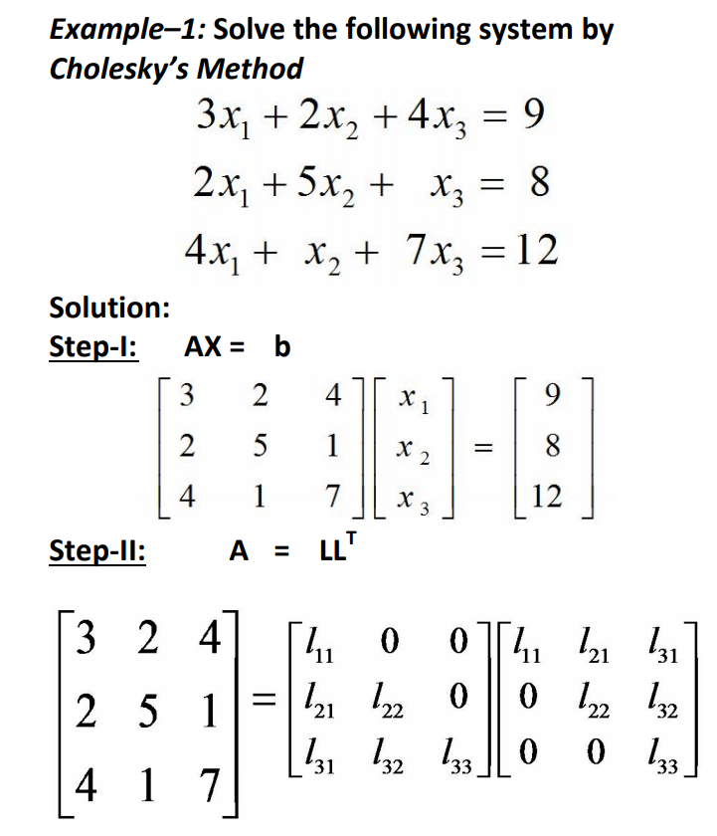




Slide 5
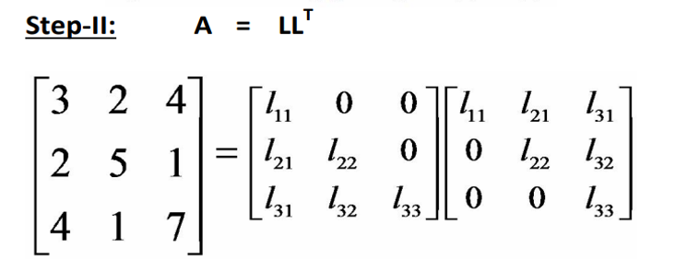
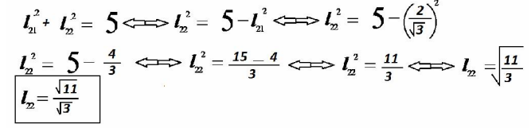
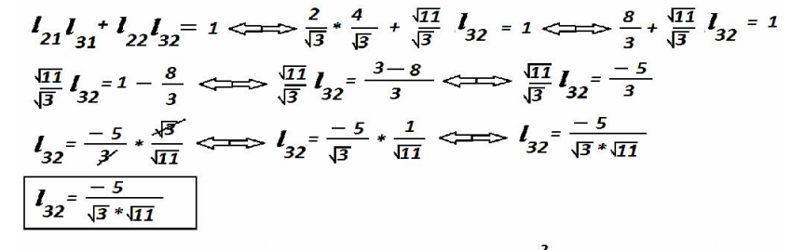
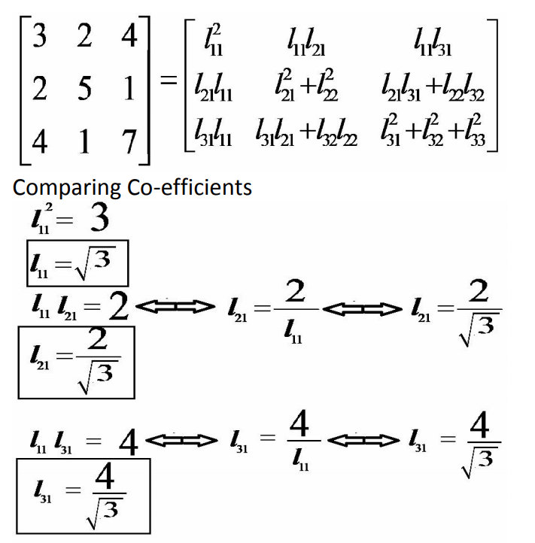
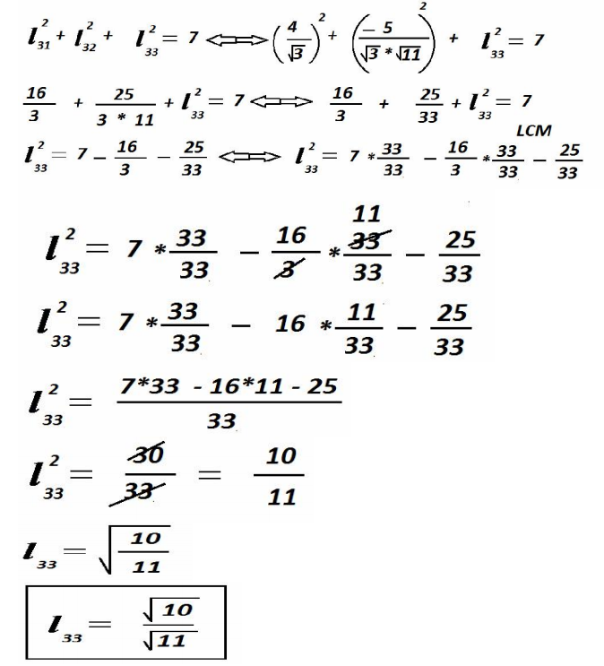

Slide 6
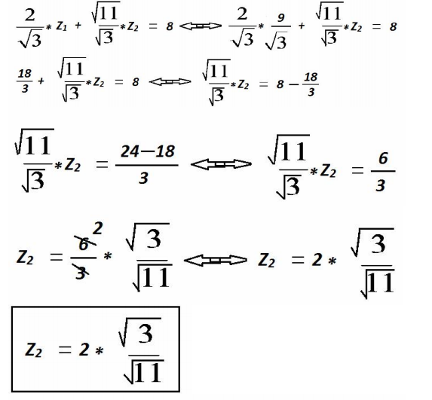
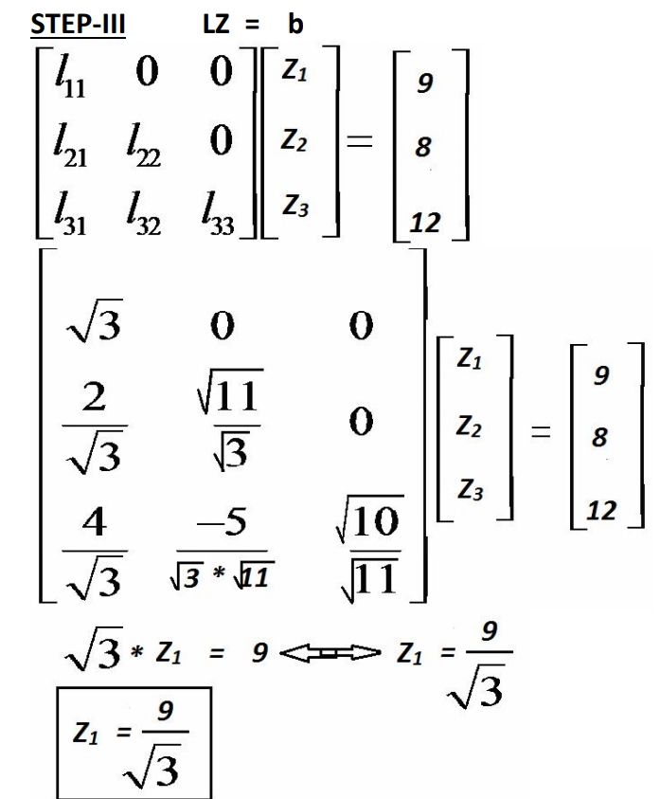
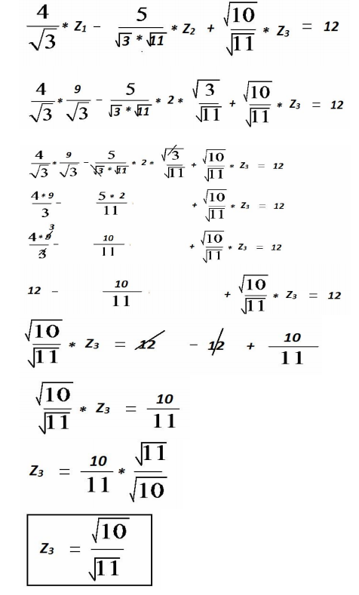

Slide 7
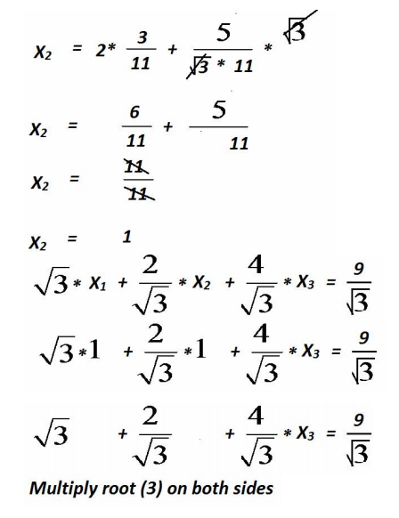
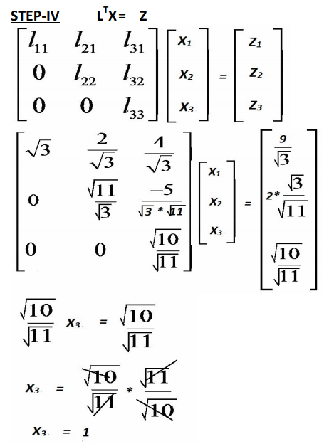
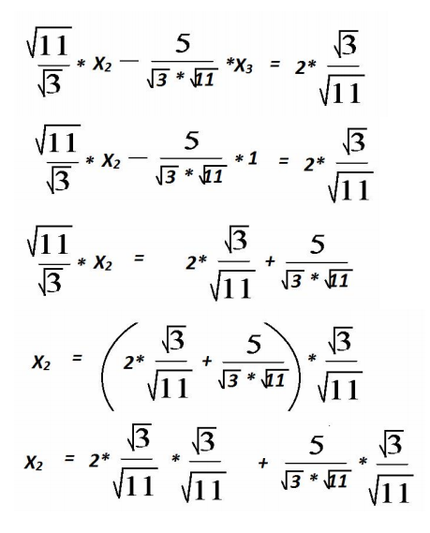
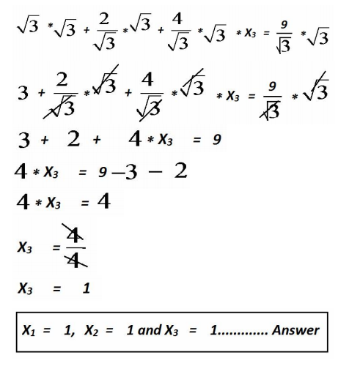

Slide 8
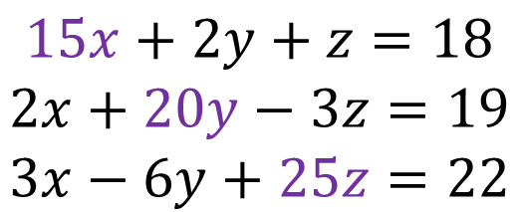
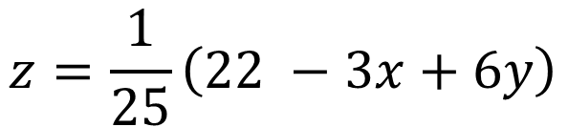
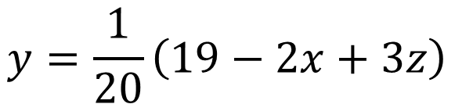
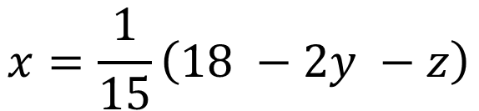
$$Q:Solve the Equations by Jacobi^{′}s Iteration Method$$
$$15x+2y+z=18$$
$$2x+20y−3z=19$$
$$3x−6y+25z=22$$
We observed in equations all diagonal values are greater than other variables in same row, than Jacobi’s applicable to solve system of linear equations
$$x=\frac{1}{15}\left(18 −2y −z\right)$$
$$y=\frac{1}{20}\left(19−2x+3z\right)$$
$$z=\frac{1}{25}\left(22 −3x+6y\right)$$

Slide 9
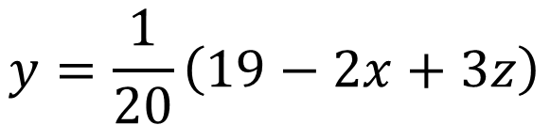
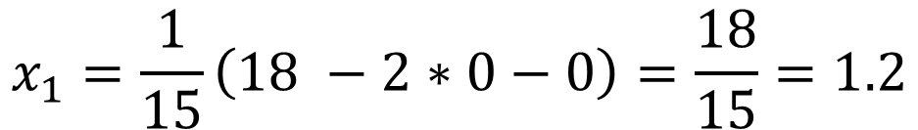
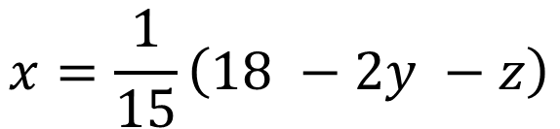

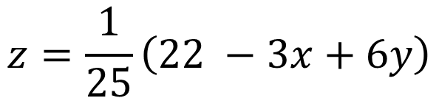
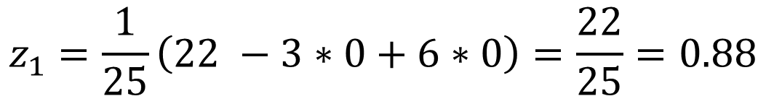
$$x=\frac{1}{15}\left(18 −2y −z\right)$$
$$y=\frac{1}{20}\left(19−2x+3z\right)$$
$$z=\frac{1}{25}\left(22 −3x+6y\right)$$
$$First Iteration$$
$$Put x=0, y=0 and z=0 OR x_{0}=0,y_{0}=0 and{ z}_{0}=0$$
$$x_{1}=\frac{1}{15}\left(18 −2∗0−0\right)=\frac{18}{15}=1.2$$
$y_{1}=\frac{1}{20}\left(19−2∗0+3∗0\right)=\frac{19}{20}=0.95$
$$z_{1}=\frac{1}{25}\left(22 −3∗0+6∗0\right)=\frac{22}{25}=0.88$$

Slide 10
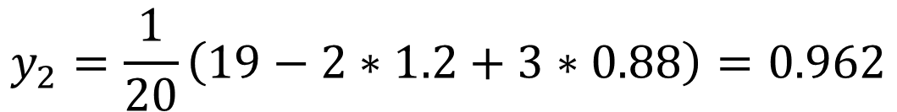
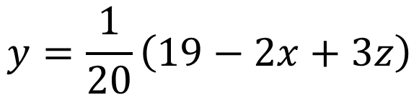
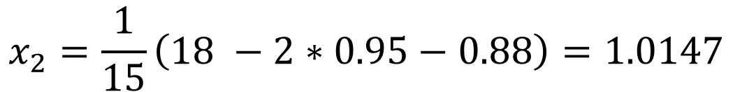
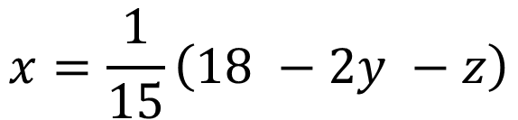

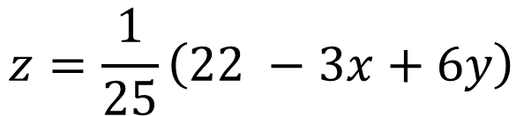
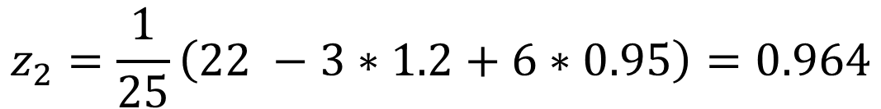
$$Second Iteration$$
$$x=\frac{1}{15}\left(18 −2y −z\right)$$
$$Put x_{1}=1.2,y_{1}=0.95 and z_{1}=0.88$$
$$y=\frac{1}{20}\left(19−2x+3z\right)$$
$$x_{2}=\frac{1}{15}\left(18 −2∗0.95−0.88\right)=1.0147$$
$$z=\frac{1}{25}\left(22 −3x+6y\right)$$
$$y_{2}=\frac{1}{20}\left(19−2∗1.2+3∗0.88\right)=0.962$$
$$z_{2}=\frac{1}{25}\left(22 −3∗1.2+6∗0.95\right)=0.964$$

Slide 11
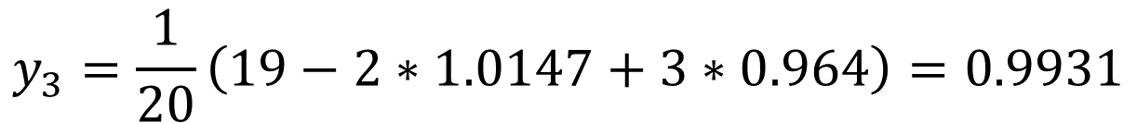
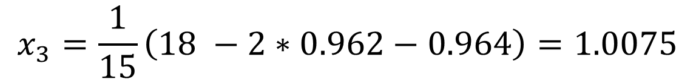

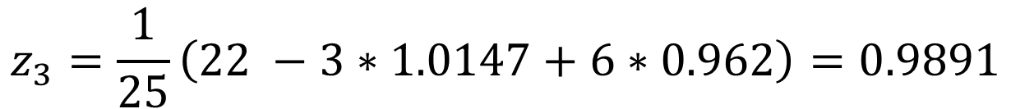
$$Third Iteration$$
$$x=\frac{1}{15}\left(18 −2y −z\right)$$
$$Put x_{2}=1.0147,y_{2}=0.962 and z_{2}=0.964$$
$$y=\frac{1}{20}\left(19−2x+3z\right)$$
$$x_{3}=\frac{1}{15}\left(18 −2∗0.962−0.964\right)=1.0075$$
$$z=\frac{1}{25}\left(22 −3x+6y\right)$$
$$y_{3}=\frac{1}{20}\left(19−2∗1.0147+3∗0.964\right)=0.9931$$
$$z_{3}=\frac{1}{25}\left(22 −3∗1.0147+6∗0.962\right)=0.9891$$

Slide 12
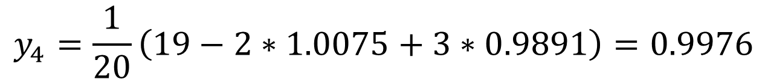
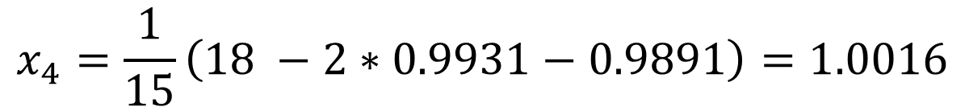

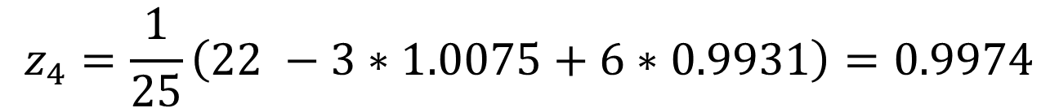
$$Fourth Iteration$$
$$x=\frac{1}{15}\left(18 −2y −z\right)$$
$$Put x_{3}=1.0075,y_{3}=0.9931 and z_{3}=0.9891$$
$$y=\frac{1}{20}\left(19−2x+3z\right)$$
$$x_{4}=\frac{1}{15}\left(18 −2∗0.9931−0.9891\right)=1.0016$$
$$z=\frac{1}{25}\left(22 −3x+6y\right)$$
$$y_{4}=\frac{1}{20}\left(19−2∗1.0075+3∗0.9891\right)=0.9976$$
$$z_{4}=\frac{1}{25}\left(22 −3∗1.0075+6∗0.9931\right)=0.9974$$

Slide 13
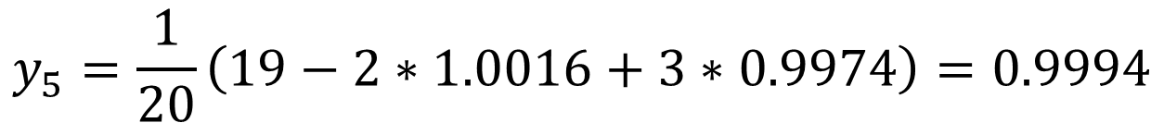
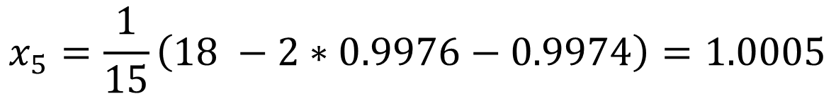

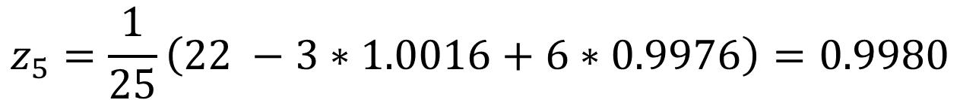
$$Fifth Iteration$$
$$x=\frac{1}{15}\left(18 −2y −z\right)$$
$$Put x_{4}=1.0016,y_{4}=0.9976 and z_{4}=0.9974$$
$$y=\frac{1}{20}\left(19−2x+3z\right)$$
$$x_{5}=\frac{1}{15}\left(18 −2∗0.9976−0.9974\right)=1.0005$$
$$z=\frac{1}{25}\left(22 −3x+6y\right)$$
$$y_{5}=\frac{1}{20}\left(19−2∗1.0016+3∗0.9974\right)=0.9994$$
$$z_{5}=\frac{1}{25}\left(22 −3∗1.0016+6∗0.9976\right)=0.9980$$

Slide 14
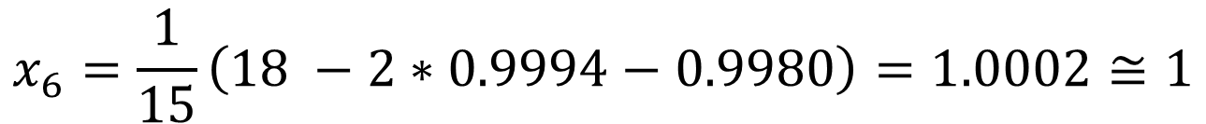


$$Sixth Iteration$$
$$x=\frac{1}{15}\left(18 −2y −z\right)$$
$$Put x_{5}=1.0005,y_{5}=0.9994 and z_{5}=0.9980$$
$$y=\frac{1}{20}\left(19−2x+3z\right)$$
$$x_{6}=\frac{1}{15}\left(18 −2∗0.9994−0.9980\right)=1.0002≅1$$
$$z=\frac{1}{25}\left(22 −3x+6y\right)$$
$$y_{6}=\frac{1}{20}\left(19−2∗1.0005+3∗0.9980\right)=0.9996≅1$$
$$z_{6}=\frac{1}{25}\left(22 −3∗1.0005+6∗0.9994\right)=0.9998≅1$$
$$Therefore, may be next iterations its values are equal to 1$$
$$x=y=z =1$$

Slide 15


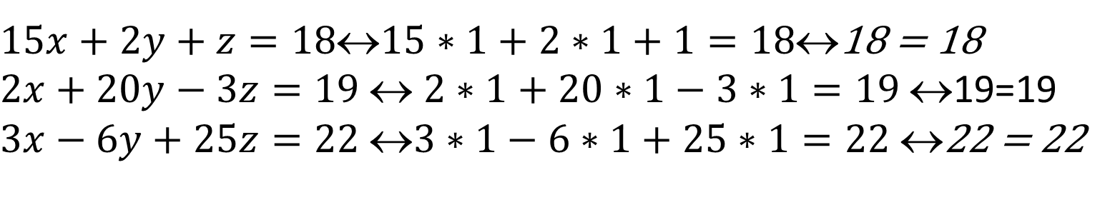
$$CHECKING$$
$$Put x=y=z =1$$
$15x+2y+z=1815∗1+2∗1+1=18$18 = 18
$2x+20y−3z=19$ $$ $2∗1+20∗1−3∗1=19$ $$19=19
$3x−6y+25z=22$ $3∗1−6∗1+25∗1=22$ $$22 = 22

Slide 16
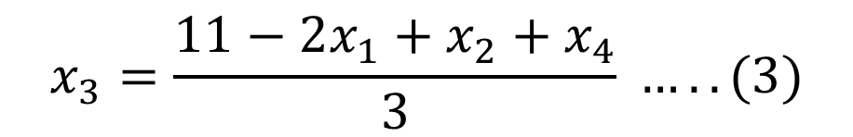


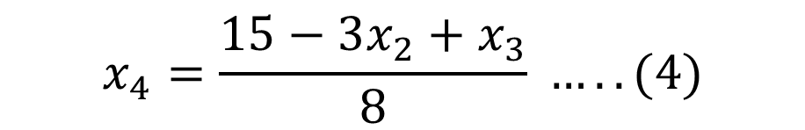


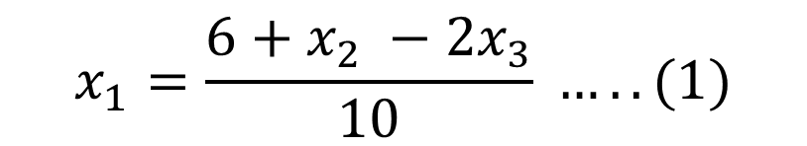

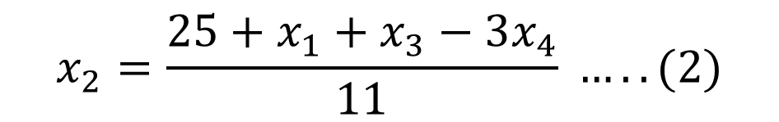
Gauss Seidal Method
$$Q:Consider the following system of linear equations, using Gauss Seidal$$
$Method$ to solve next iteration
$10x_{1}−$ $x_{2}+2x_{3}=6$
$$−x_{1}+11x_{2}−x_{3}+3x_{4}=25$$
${2x}_{1}−$ $x_{2}+10x_{3}−x_{4}=11$
$$3x_{2}−x_{3}+8x_{4}=15$$
$$Initial guess{ x}_{1}=0,x_{2}=0,x_{2}=0$$
$$SOLUTION$$
$$x_{3}=\frac{11−2x_{1}+x_{2}+x_{4}}{3} …..(3)$$
$$x_{1}=\frac{6+x_{2} −2x_{3}}{10} …..(1)$$
$$x_{4}=\frac{15−3x_{2}+x_{3}}{8} …..(4)$$
$$x_{2}=\frac{25+x_{1}+x_{3}−3x_{4}}{11} …..(2)$$

Slide 17
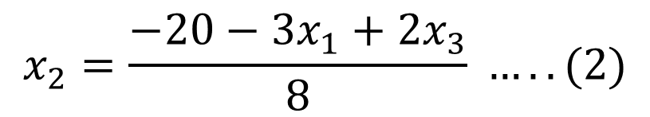
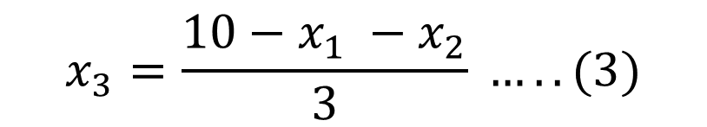
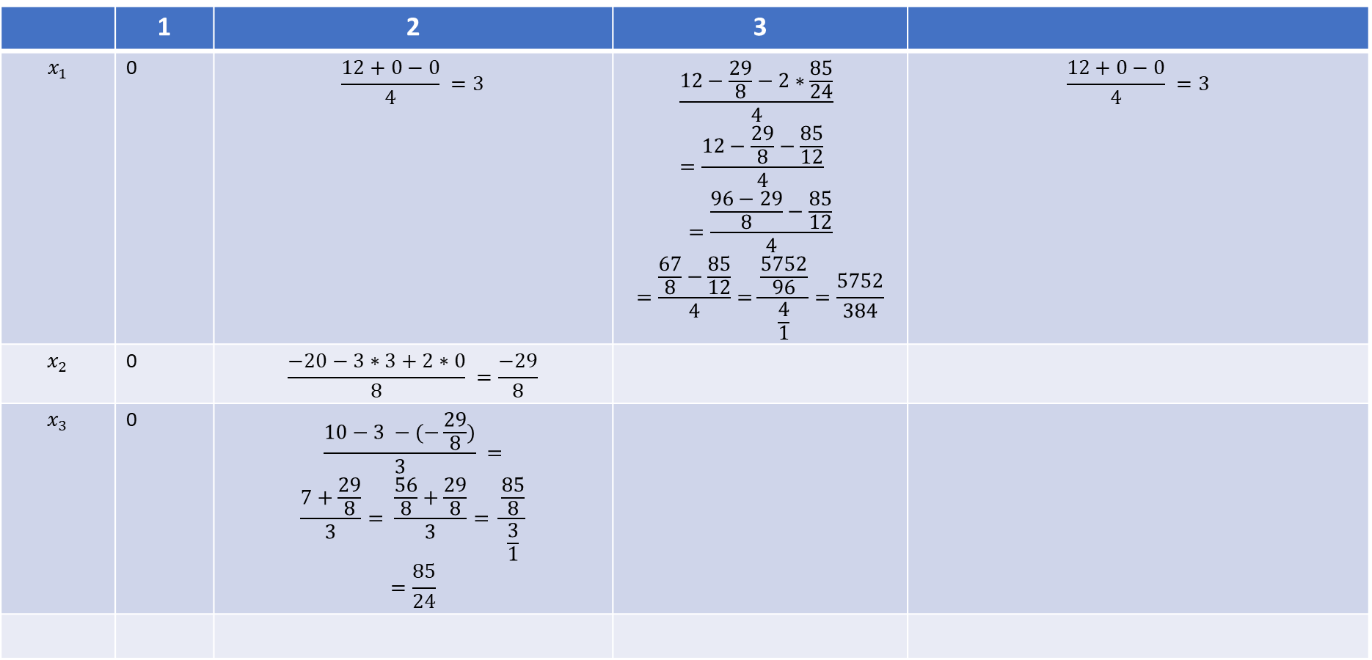
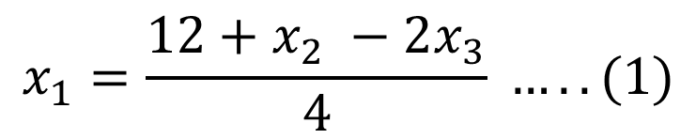
$$x_{1}=\frac{12+x_{2} −2x_{3}}{4} …..(1)$$
$$x_{2}=\frac{−20−3x_{1}+2x_{3}}{8} …..(2)$$
$$x_{3}=\frac{10−x_{1} −x_{2}}{3} …..(3)$$
 | 1 | 2 | 3
$$x_{1}$$ | 0 | $$\frac{12+0−0}{4} =3$$ | $$\frac{12−\frac{29}{8}−2∗\frac{85}{24}}{4} =\frac{12−\frac{29}{8}−\frac{85}{12}}{4}$$ $$=\frac{\frac{96−29}{8}−\frac{85}{12}}{4}$$ $$=\frac{\frac{67}{8}−\frac{85}{12}}{4}=\frac{\frac{5752}{96}}{\frac{4}{1}}=\frac{5752}{384}$$ | $$\frac{12+0−0}{4} =3$$
$$x_{2}$$ | 0 | $$\frac{−20−3∗3+2∗0}{8} =\frac{−29}{8}$$
$$x_{3}$$ | 0 | $$\frac{10−3 −(−\frac{29}{8})}{3} =$$ $$\frac{7+\frac{29}{8}}{3}= \frac{\frac{56}{8}+\frac{29}{8}}{3}= \frac{\frac{85}{8}}{\frac{3}{1}}$$ $$=\frac{85}{24}$$

Slide 18
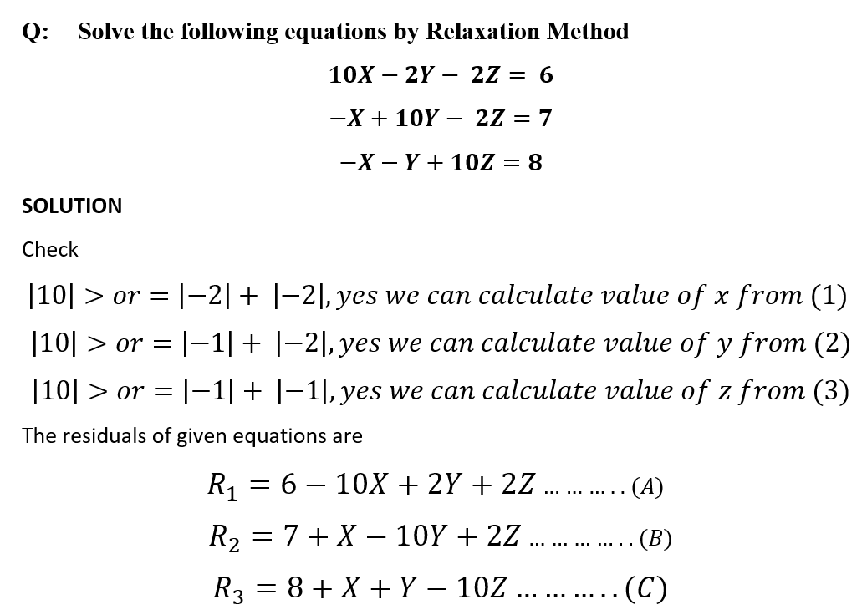


Slide 19
Newton Raphson Method
X_{n+1} = X_{n} – f(x_{n} )/ f’ (x_{n} )
Example: Apply newton Raphson Method, to find the real roots of equation
f(x) = 3x – cos(x) - 1
f’(x) = 3 + sin(x)

Slide 20
Newton Raphson Method
Value*(180/pi) = 57.2957 values in degree
f(x) = 3x – cos(x) - 1
f(0) = 3*0 – cos(0) - 1 = -Ve
f(1) = 3*1 – cos (57.2957) - 1 = +ve
x₀ = 0.6

Slide 21

Newton Raphson Method
X_{n+1} = X_{n} – f(x_{n} )/ f’ (x_{n} )
X_{n+1} = X_{n} –{3x – cos(x) - 1}/ {3 + sin(x) }
-------------(A)
Put n = 0
x₁ = [x₀ *sinx₀ + cosx₀ + 1]/(3 + sinx₀)
x₁ = [0.6 *sin(0.6* 57.2957 ) + cos(0.6* 57.2957) + 1]/(3 + sin(0.6* 57.2957 ))
x₁ = 0.6071

Slide 22
Newton Raphson Method
Put n = 1
x₂ = [x₁ *sinx₁ + cosx₁ + 1]/(3 + sinx₁)
x₂ = [0.6071 *sin(0.6071* 57.2957) + cos(0.6071* 57.2957) + 1]/(3 + sin(0.6071* 57.2957))
x₂ = 0.6071

